Slide 1
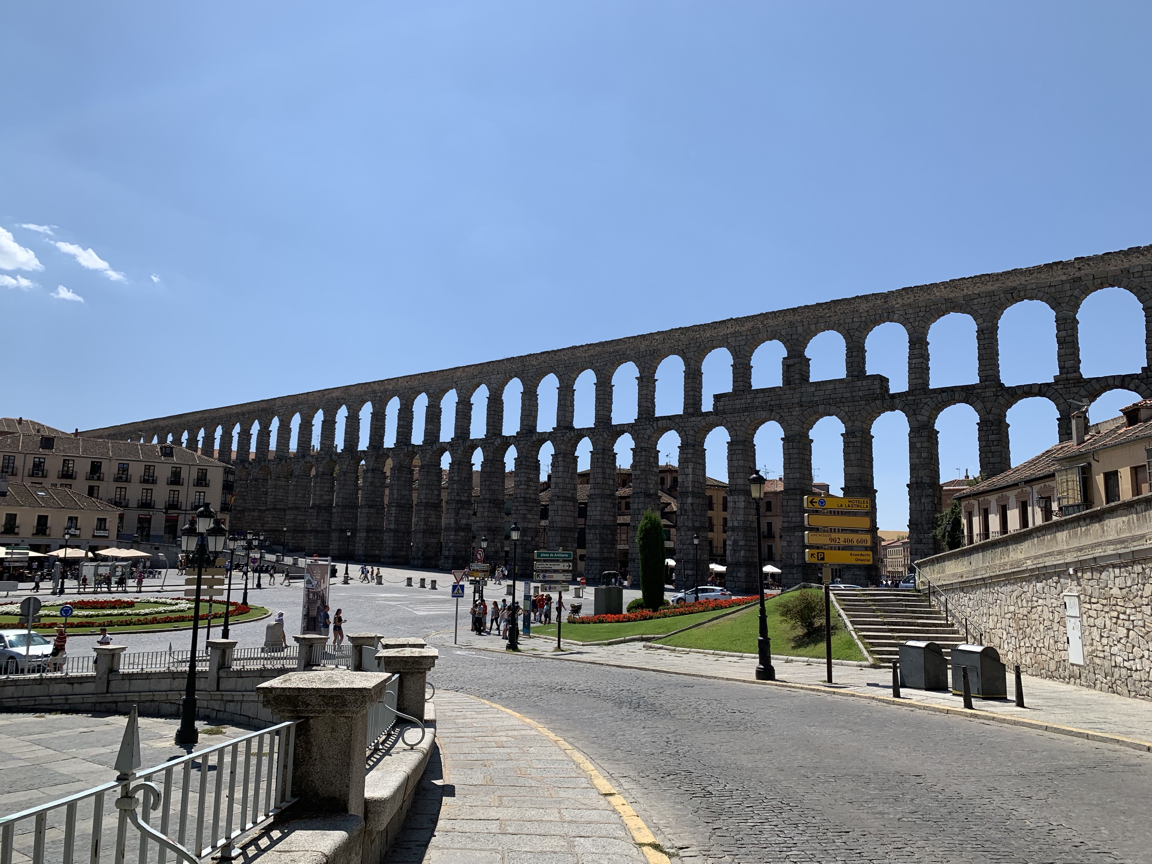
“Darling, what am I looking at?”
Charlie Lew

Slide 2
Motivation & Objective

Slide 3
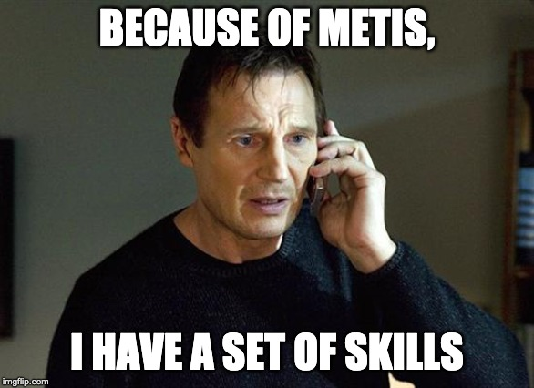
Motivation & Objective

Slide 4
Motivation & Objective
Objective
Create an automatic text-to-speech caption generator for the visually impaired via Deep Learning

Slide 5
Data & Tools

Slide 6

Data & Tools
Dataset: Flickr 8,000 annotated images
Annotations created by Mechanical Turk

Slide 7



Data & Tools
Dataset: Flickr 8,000 annotated images
Annotations created by Mechanical Turk
Tools
Python, Pandas, Scikit-Learn, Numpy
TensorFlow & Keras
Matplotlib, Seaborn
Google Text-to-Speech (gTTS)
Flask

Slide 8
Methodology Pipeline

Slide 9
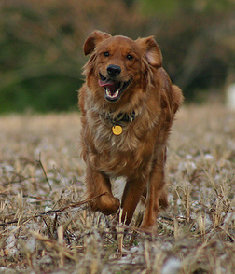
Methodology Pipeline
1. Image
Annotated:
“Brown dog is running through the field”

Slide 10
Methodology Pipeline
1. Image
2. Feature Extraction
Convolutional Neural Network (CNN)
VGG16
Annotated:
“Brown dog is running through the field”
Vocabulary from Flickr dataset
(~4,000 words)

Slide 11
Methodology Pipeline
1. Image
2. Feature Extraction
3. Decoder
Convolutional Neural Network (CNN)
VGG16
Recurrent Neural Network (RNN)
with LSTM
Annotated:
“Brown dog is running through the field”
LSTM
Vocabulary from Flickr dataset
(~4,000 words)

Slide 12
Methodology Pipeline
1. Image
2. Feature Extraction
3. Decoder
Convolutional Neural Network (CNN)
VGG16
Recurrent Neural Network (RNN)
with LSTM
Annotated:
“Brown dog is running through the field”
LSTM
Vocabulary from Flickr dataset
(~4,000 words)

Slide 13
Methodology Pipeline
1. Image
2. Feature Extraction
3. Decoder
4. Caption!
Convolutional Neural Network (CNN)
VGG16
Recurrent Neural Network (RNN)
with LSTM
Predicted:
“Brown dog is running in the grass”
Annotated:
“Brown dog is running through the field”
LSTM
Vocabulary from Flickr dataset
(~4,000 words)

Slide 14
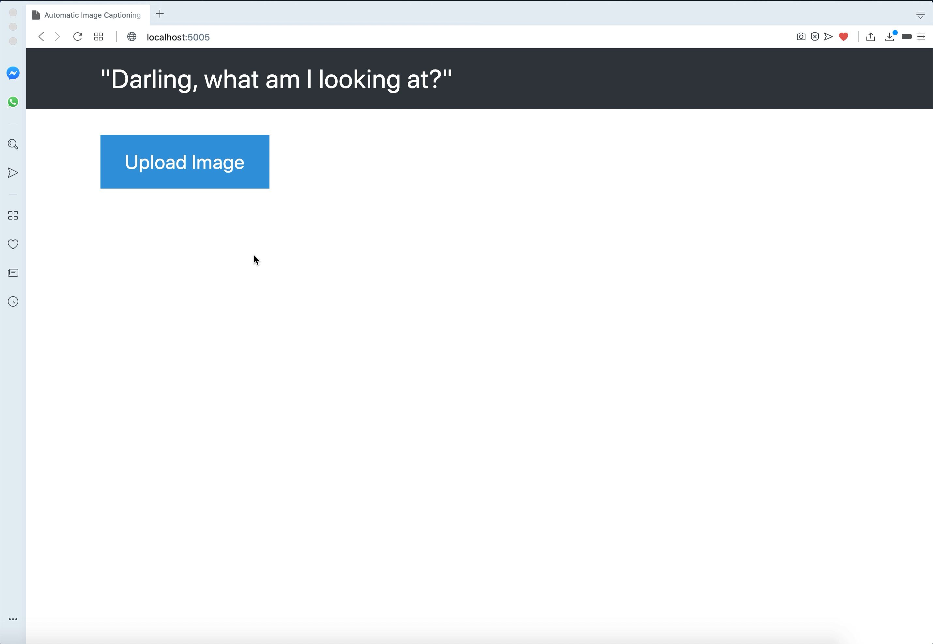
Flask App Demonstration

Slide 15

Future Work
Further improve RNN & Metrics
Hyper-parameter tuning, Attention Model, BLEU
Need more data!
Flickr: 30,000
MSCOCO: 100,000
Google: Several million
Extend to paintings, videos, etc.

Slide 16

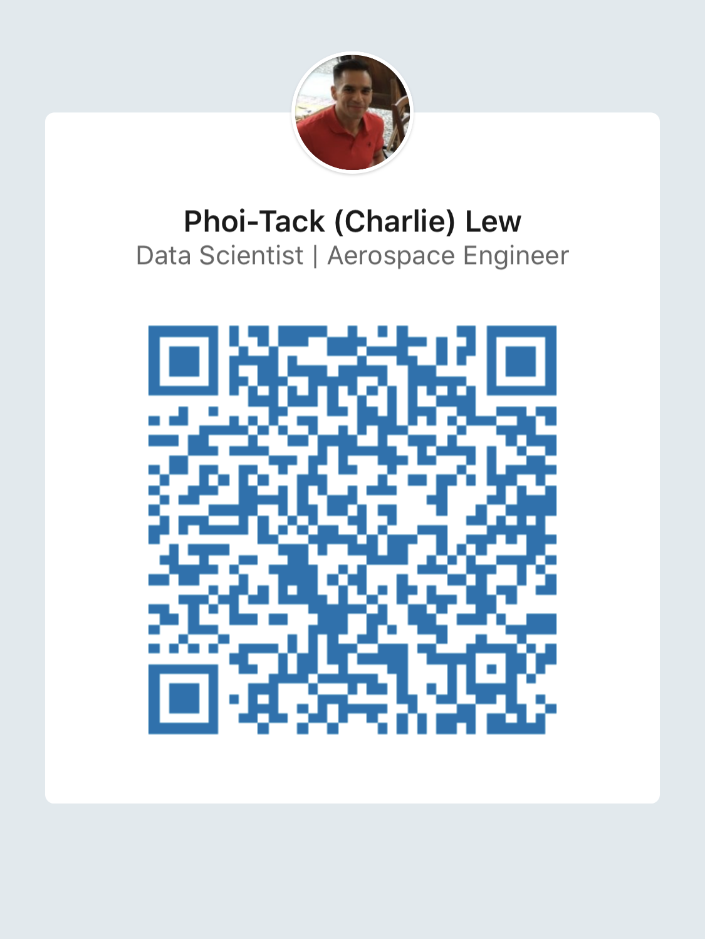


Thank You
Phoi-Tack (Charlie) Lew
phoitack@gmail.com
/in/charlielew

Slide 17
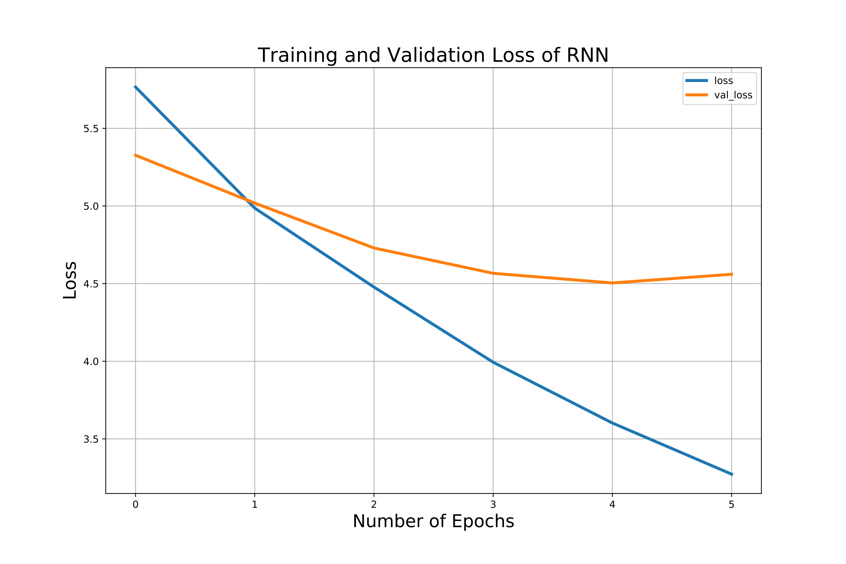
Appendix

